Slide 1
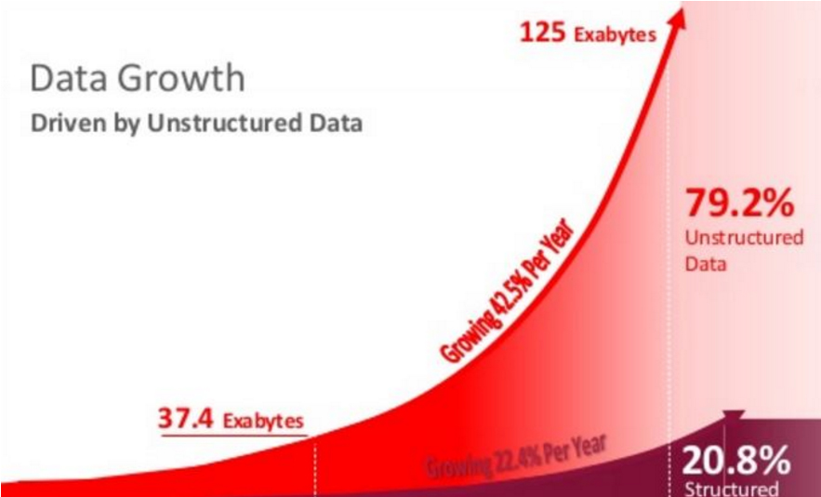

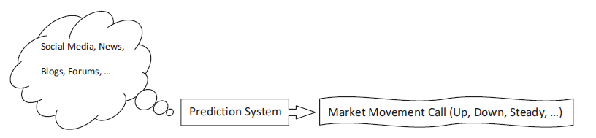
LITERATURE REVIEW ON TEXT MINING FOR MARKET PREDICTION: A SYSTEMATIC REVIEW Arman Khadjeh Nassirtoussi, Saeed aghabozorgi, David chek ling ngo
Vignesh j muralidharan

Slide 2
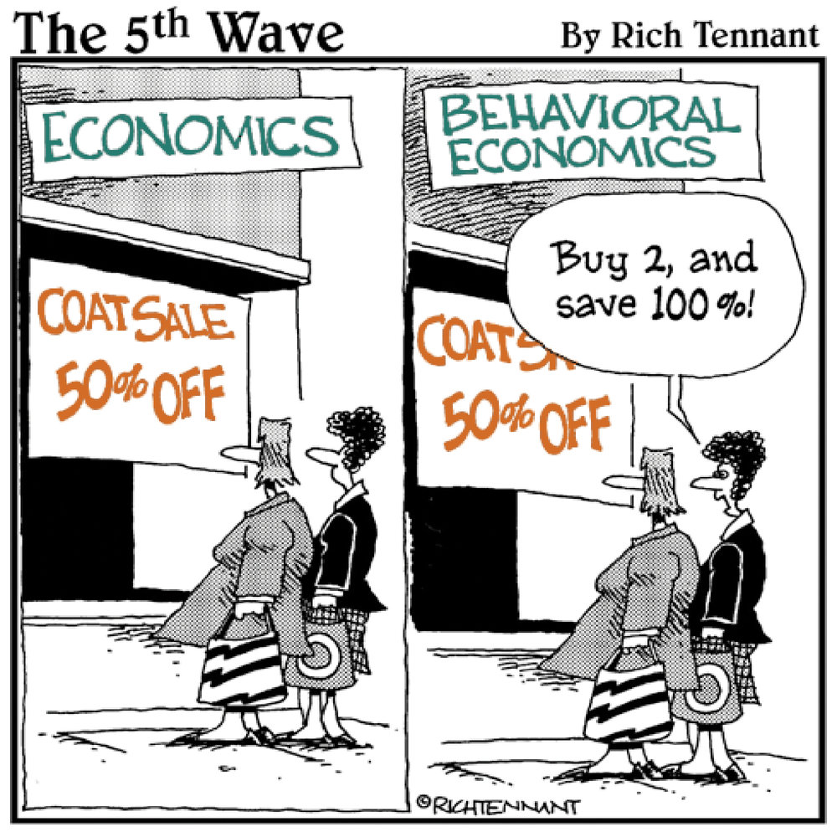
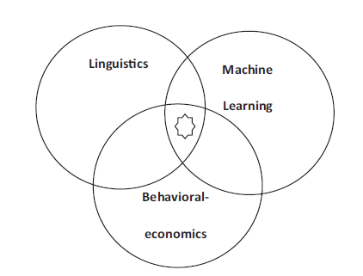
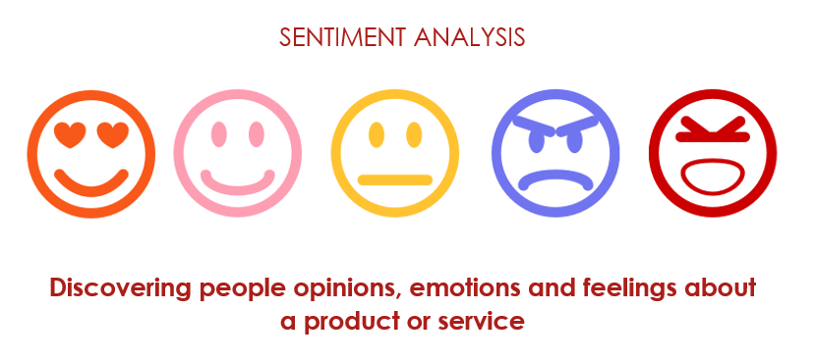
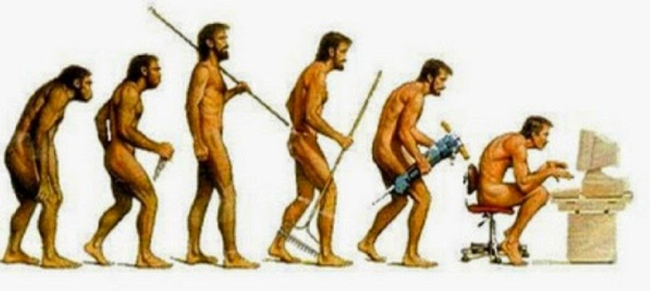
BACKGROUND TOPICS TO BE KNOWN
Market conditions are products of human behaviors involved- Bilas 2007
Efficient Market Hypothesis (EMH)
Behavioral Economics
Adaptive market hypothesis
Fundamental vs Technical Analysis
Sentiment and emotional analysis

Slide 3
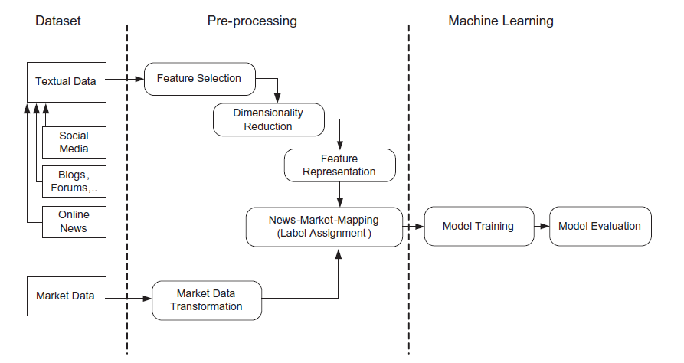
OUTLINE

Slide 4

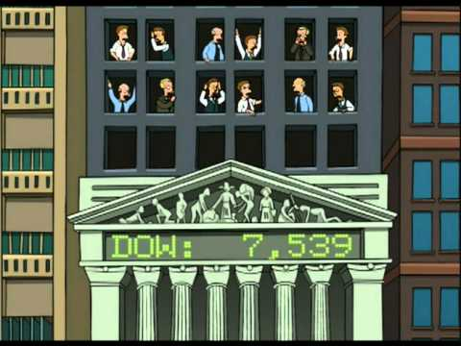
DATA INPUT
AUTHOR | TEXT DATA FROM
Das and Chen (2007) | Online message boards
Chang (2012) | Twitter post and mood analysis for market predictions
Bollen (2011) | Companies annual reports
Chatrath et al (2014) | Frequency of recent news
AUTHOR | MARKET DATA FROM
Wuthrich et al (2007) | NASDAQ
Zhai (2007) | FOREX
Hagenau (2013) | Stock price of companies like google, yahoo, Microsoft

Slide 5


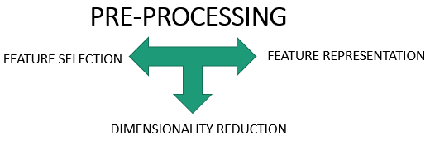
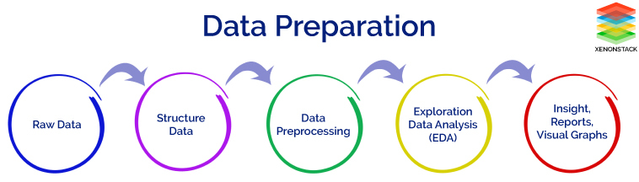
TIME FOR ACTION

Slide 6
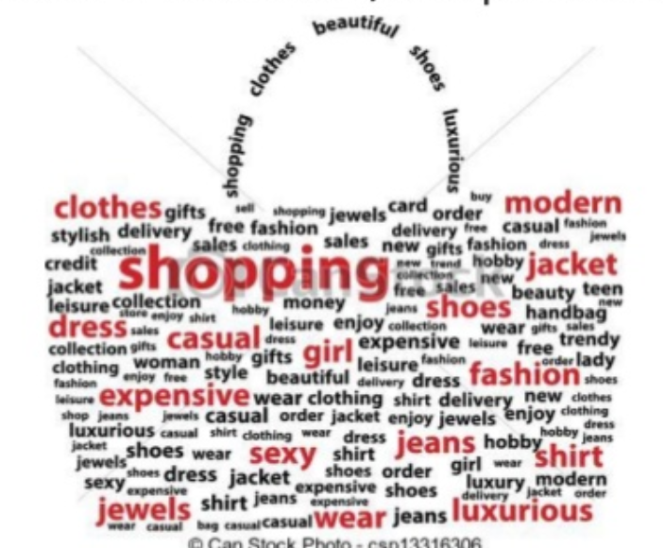
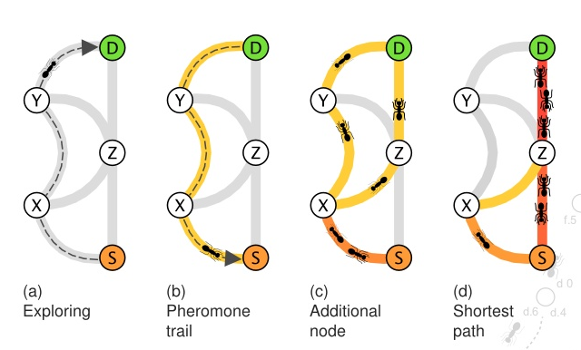

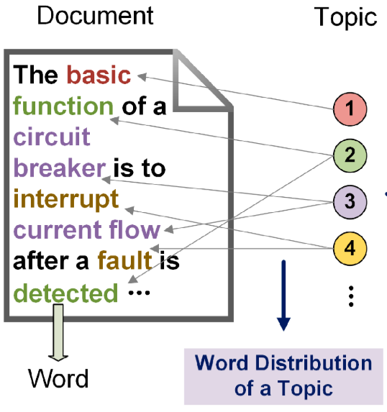
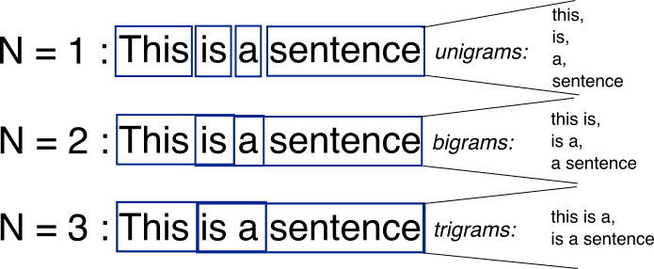
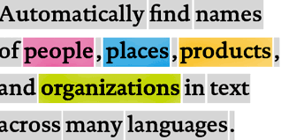
Bag-of-Words - Kleinnijenhuis et al (2003)
FEATURE SELECTION
Ant Colony Optimization -Tsai.Eberle (2013)
Noun Phrases - Schumaker et al (2012)
Latent Dirichlet Allocation (LDA) – Jin et al (2013)
N-gram model – Butler (2013)
Named Entity Recognition – Ve etal (2012)

Slide 7
DIMENSIONALITY - REDUcTION
WE HAVE THE CURSE OF DIMENSIONALITY IF WE HAVE INCREASED NUMBER OF FEATURES – Pestov (2013)
AUTHOR | APPROACH USED
Zhai et al (2007) | Minimum occurrence limit and reducing the terms by selecting once reaching a number of occurrence
Butler (2009) | Using predefined dictionary
Wuthrich et al (2008) | Use subject field particular example: Psychology
Soni (2007) | Use of WordNet Thesaurus
Pui Cheong (2003) | Conversion to lowercase letters, punctuation removal, numbers
Berka (2013) | Parallel Rare term vector replacement

Slide 8

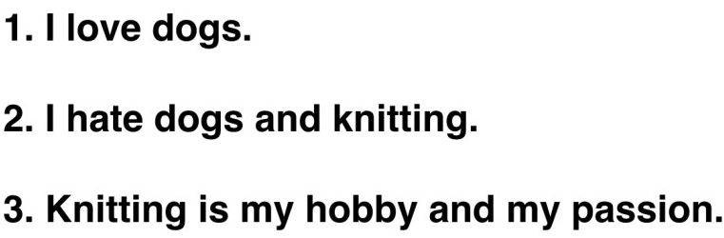
FEATURE REPRESENTATION I can understand do
?
1. Tasci and Gungor (2013)
Information Gain (IG) – Metric measures reduction in entropy by knowing the presence or absence of a term in document
Chi-Square Statistics (CHI) – Find Occurrence of a term “t” and occurrence of a class “c”
Document Frequency (DF) – Counts the number of documents in which a term appears and selects the terms with higher count
Accuracy balanced (Acc2) – Two sided metric similar to IG and CHI
2. Wuthrich et al (1998)
Term Frequency Category Discrimination metric

Slide 9
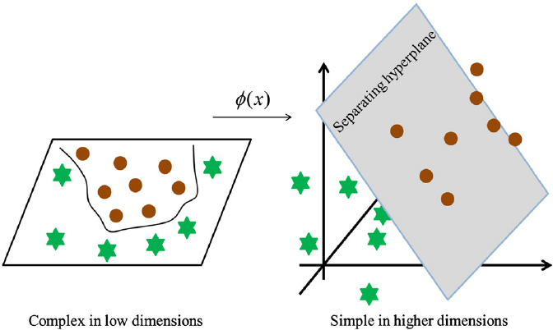
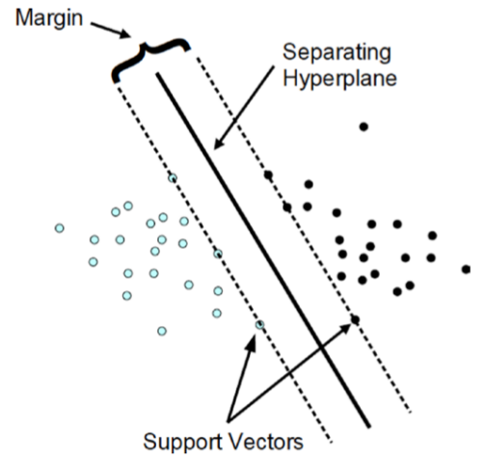
Machine Learning
Support vector machine – Zhai et al (2007) – Finding a hyperplane that separates two classes with a maximum margin
Kernel map (Non-linear Classifier)– Original classification problem is transformed into a higher dimensional space
Document map (Linear classifier) - Each news is positioned on weighted average of the coordinates

Slide 10
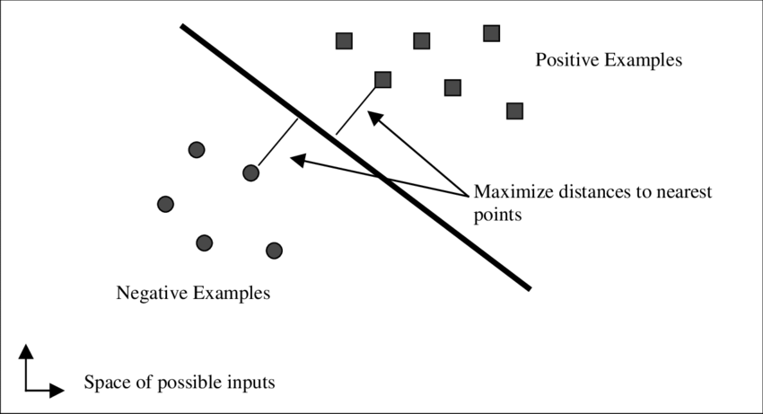
2. Regression Algorithms
AUTHOR | METHOD | USED FOR
Drucker (1997) | Support Vector Regression | To predict the discrete value of the stock return
Schumaker et al (2012) | Sequential Minimal Optimization | Allows discrete numeric prediction instead of classification
3. NAÏVE BAYES
AUTHOR | USED FOR
Duan and Cao (2013) | Sentiment Analysis of social media along with effect of Conventional media
Li (2010) – (Perl Language) | To examine the information content of the forward looking statements in management discussion of the company

Slide 11
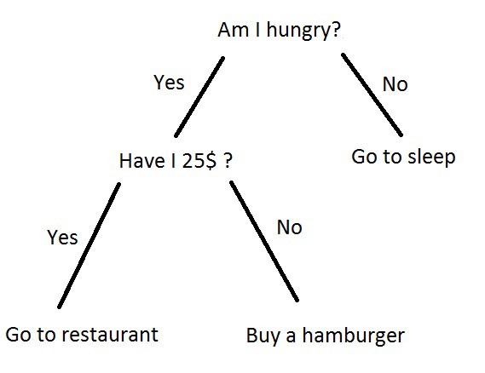
4. Decision rules and trees
AUTHOR | METHOD | USED FOR
Peramunetilleke (2002) | Rule based classification systems – expressing correlation between keywords yields a probability how likely the event will occur | DOLLAR_UP DOLLAR_DOWN DOLLAR_STEADY
Huang et al (2010) | Weighted association rules algorithm – combination of two or more keywords in financial news headline to detect compound terms | Predict next trading day
Quinlan (2007) | C 4.5 – yields set of trend predicting rules with combination of numerical and textual data | Stock prices
Weiss et al (2010) | Decision Tree – Dividing document into non-overlapping regions

Slide 12
5. Combinatory algorithms
AUTHOR | ALGORITHMS | USED FOR
Butler (2009) | N-gram & SVM | N-gram for each company annual report SVM combines readability scores with performance output
Bollen (2004) | Naïve Bayes, SVM | Public mood measurements
Werner (2011) | Naïve Bayes, KNN & ANN | Detect patterns in textual data & Risk exposure in Stock market
SVM has been successful and used as textual classification and sentiment learning approach
AUTHOR | ALGORITHM USED
Li Yang (2012) | Artificial Neural Network with SVM
Kuang(2012) | KNN & SVM
Gradojevic (2013) | Fuzzy-logic Neural Network & SVM

Slide 13
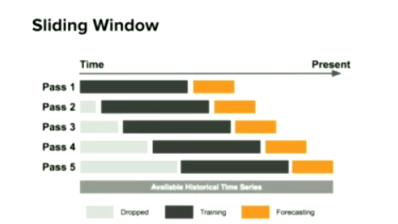
SLIDING WINDOW MARKET ANALYSIS FOR TIME SERIES DATA

Slide 14
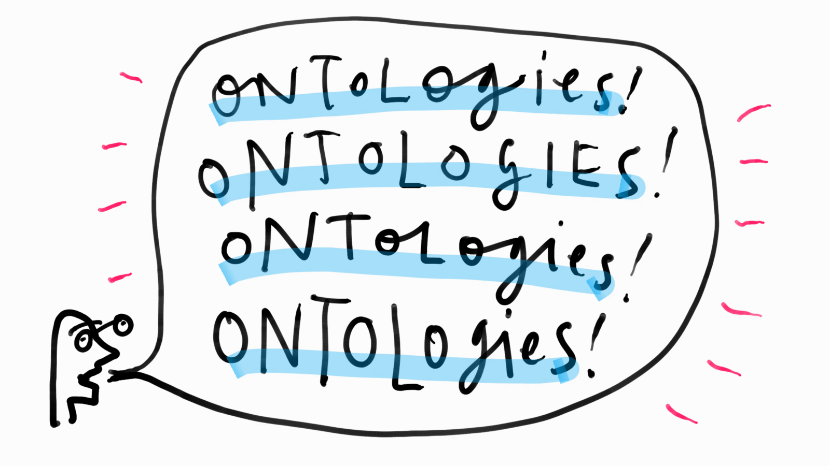
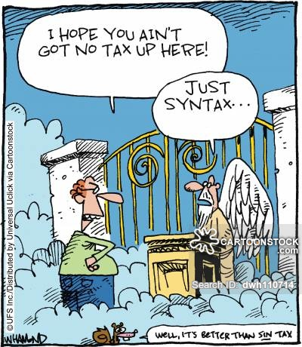
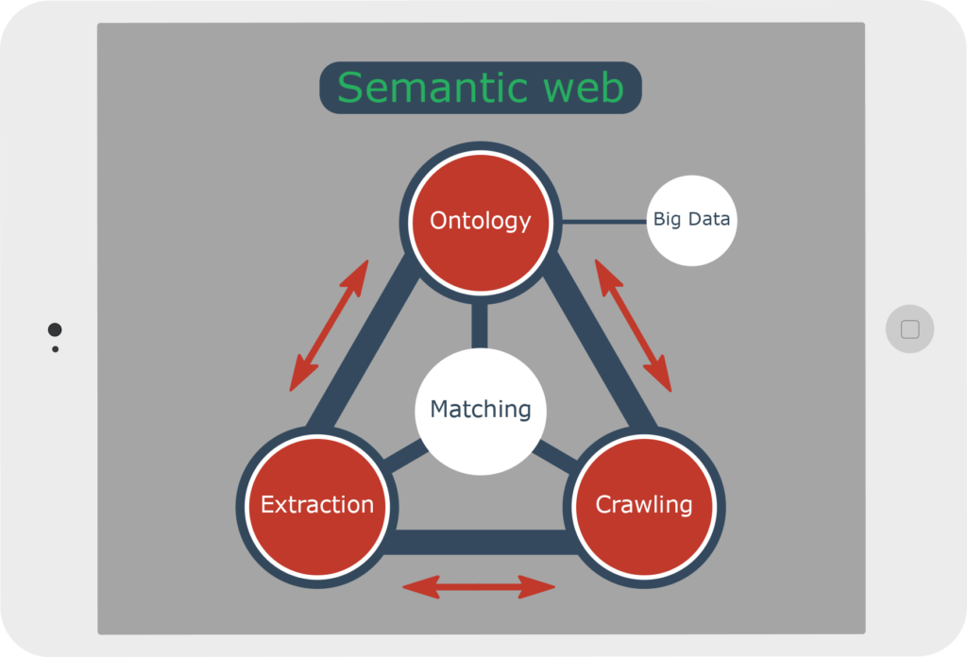
SEMANTICS & SYNTAX
Deals with Meaning
of words
Words order and relative groupings
AUTHOR | ALGORITHIM NAME | USED FOR
Kim et al (2014) | Language independent semantic kernel (LIS) | Compute the similarity between short text documents without using grammatical tags and lexical database
Griffith (2005) | Hidden Markov Model (HMM-LDA) | Recognize the typical word can play different roles. It can either be part of content and serve in a semantic or in context behavior

Slide 15
Ways of evaluation
Testing for accuracy, recall or precision and sometimes f-measure is most common
Range of 50-70% considered better choice.
Trading period is simulated and profits are measured to evaluate the viability of the system

Slide 16
conclusion
Predominant gaps that exist within the major market prediction have been identified
Market movements based on insights into human psychology through text mining are widely available resources in real time
The work is hoped to help other researchers with strategic decisions in design of future systems
Future work
Semantics
Syntax
Sentiment analysis of public
Machine learning algorithms
Publish quality and standardized datasets

Slide 17


